Slide 1


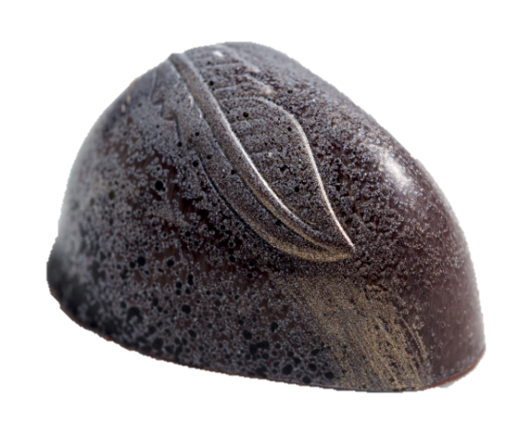
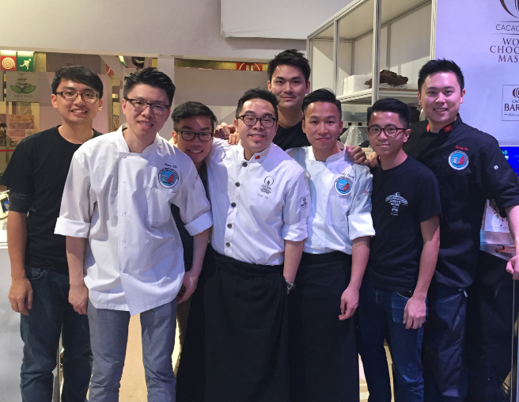
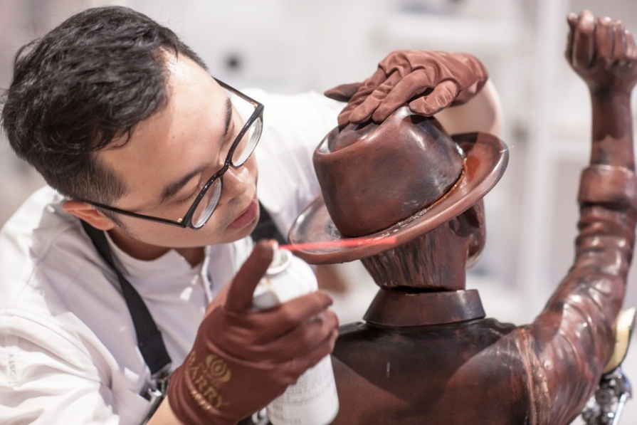
Meet Our Young
Chocolate masters
Supporting Organization
April 26, 2016
10:00 am to 17:00 pm
1/F, VTC Pokfulam Complex
REPLY SLIP
Email to: anita@ultrafuture.com.hk with the REPLY SLIP on or before April 16, 2016
Name
Job Title
Establishment
Mobile No
Email
Will notify your registration status after the registration deadline

